Slide 1
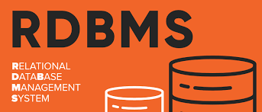
Relational Database Management Systems - Intro
Dr Ilayaraja N
1

Slide 2
Some Preliminaries
Relational Data Model was originally devised by Edgar F. Codd in 1969. His seminal paper (1970) was entitled A Relational Model of Data for Large Shared Data Banks.
An organised, machine-readable collection of symbols, to be interpreted as a true account of some enterprise.
… so a database is also a collection of tables/relations.

Slide 3
Basic Definition
Data: raw facts
Constitute building blocks of information
Known facts that can be recorded and that have implicit meaning
Information: is produced by processing data and reveals meaning of data
timely, relevant information key to decision making
decision making key to organizational survival
Database: a collection of Data
End user data (Operational Data) - Stored in Table
Metadata – Stored in System Catalog/Data Dictionary

Slide 4
Database Definition
Database
A collection of logically inter-related organized persistent shared data stored in a standardized format, designed to be shared by multiple users.
4
Notes:
4

Slide 5
DBMS Definition
A collection of programs that manages the database structure and controls access to the data stored in the database.
DBMS Offers facilities..
Data Definition
Data Construction
Data Manipulation
Data Management
Possible to share data among multiple applications or users
Example: bank and its ATM machines
Makes data management more efficient and effective
End users have better access to more and better-managed data

Slide 6
DBMS Definition
Database Management System (Goals)
Software that defines a database, stores the data, supports a query language
To provide an efficient as well as a convenient environment for accessing data in a database
Enforce information security: database security, concurrency control, crash recovery

Slide 7
Database File Structure
Data
Raw Facts
Data Field/ Attribute/ Column
Group of characters with specific meaning
Record / Row / Tuple
Logically connected fields that describe a person, place, or thing
Table / Data File
Collection of related records

Slide 8
“Organised Collection of Symbols”
For example:
StudentId | Name | CourseId
S1 | Anne | C1
S1 | Anne | C2
S2 | Boris | C1
S3 | Cindy | C3
The symbols are organised into rows and columns, thus forming a table. One of the rows is different in kind from the others.
8
Notes:
HACD.1: Introduction to Relational Databases
*
CS252: Fundamentals of Relational Databases
8

Slide 9
“To Be Interpreted as a True Account”
For example (from the table just shown):
StudentId | Name | CourseId
S1 | Anne | C1
Perhaps those green symbols, organised as they are with respect to the blue ones, are to be understood to mean:
“Student S1, named Anne, is enrolled on course C1.”
9
Notes:
HACD.1: Introduction to Relational Databases
*
CS252: Fundamentals of Relational Databases
9

Slide 10
“Collection of Data Values”
ENROLMENT
StudentId | Name | CourseId
S1 | Anne | C1
S1 | Anne | C2
S2 | Boris | C1
S3 | Cindy | C3
S4 | Devinder | C1
ENROLMENT is a relation. If so, it (relation) has been updated since then (the row for S4 has been added).
10
Notes:
HACD.1: Introduction to Relational Databases
*
CS252: Fundamentals of Relational Databases
10

Slide 11
What Is a Relational Database?
A database whose symbols are organised into a collection of relations. Here is a relation, shown in tabular form:
StudentId | Name | CourseId
S1 | Anne | C1
S1 | Anne | C2
S2 | Boris | C1
S3 | Cindy | C3
S4 | Devinder | C1
Might be the value currently assigned to ENROLMENT, a relation variable.
11
Notes:
HACD.1: Introduction to Relational Databases
*
CS252: Fundamentals of Relational Databases
11

Slide 12
Anatomy of a Relation
StudentId | Name | CourseId
S1 | Anne | C1
attribute name
attribute values
n-tuple, or tuple. This is a 3-tuple. The tuples constitute the body of the relation. The number of tuples in the body is the cardinality of the relation.
Heading (a set of attributes) The degree of this heading is 3,
which is also the degree of the relation.
12
Notes:
HACD.1: Introduction to Relational Databases
*
CS252: Fundamentals of Relational Databases
12

Slide 13
Two Types of Data in Database
Operational Data:
Data is a set of facts and statistics that can be operated, referred or analyzed.
Business Data to describe the activities of an enterprise
Stored as records in data file/table/relation
Data may or may not have been processed.
Metadata:
Metadata describes relevant information about the data.
Is also known as the System Catalog.
It describes how, when and by whom certain data was collected as well as the format and context of the data.
A data dictionary is a centralized collection of data information
Metadata is always a processed data.

Slide 14
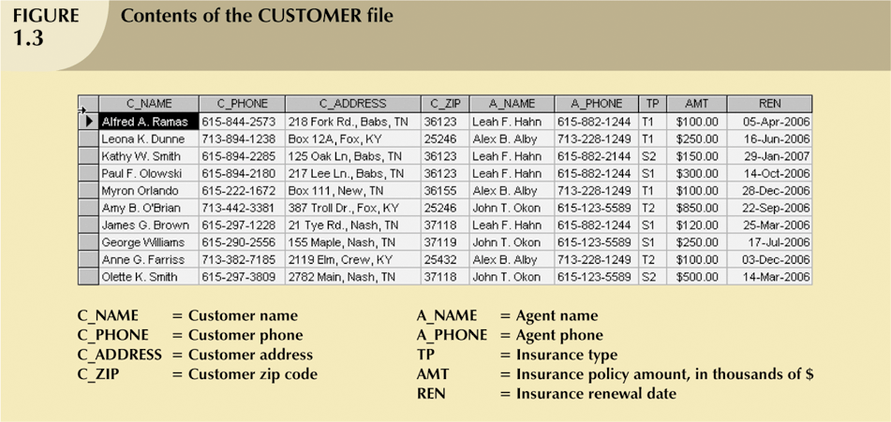
Operational Data

Slide 15
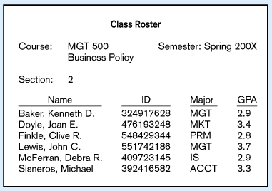
Converting Operational Data to Information

Slide 16
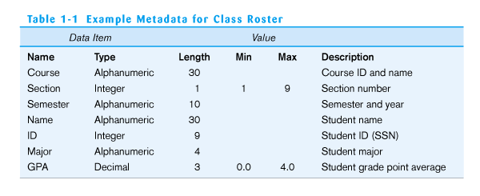
Meta Data

Slide 17
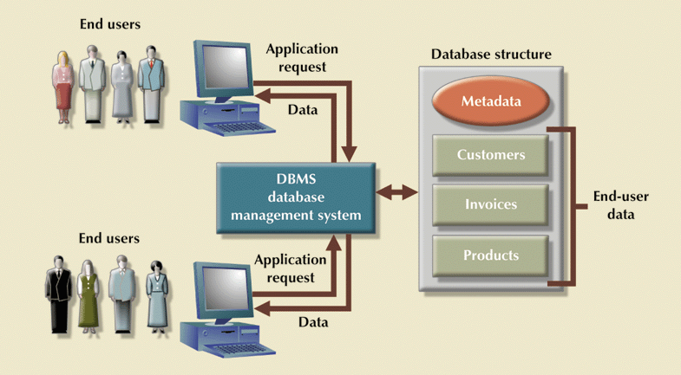
Database Manages Interaction

Slide 18
Front-End
Web Forms
SQL I/f
SQL Commands
Plan Executor
Parser
SQL Engine
Operator Evaluator
Optimizer
Tx
Manager
Files & Access
Recovery
Manager
Buffer Manager
Lock
Manager
Disk Space Manager
DBMS
Data File
Meta Data
Database
Notes:
Database Management Systems
18

Slide 19
DBMS Features/Components
Database engine
Storage
Retrieval
Update
Query Processor
Data dictionary
Utilities
Security
19
Notes:
19

Slide 20
DBMS Engine, Security, Utilities
Data
Tables
Product
ItemID Description
887 Dog food
946 Cat food
Order
OrderID ODate
9874 3-3-97
9888 3-9-97
Customer
CustomerID Name
1195 Jones
2355 Rojas
Database
Engine
Product
ItemID Integer, Unique
Description Text, 100 char
Customer
CustomerID Integer, Unique
Name Text, 50 char
Data
Dictionary
Security
User Identification
Access Rights
Concurrency and
Lock Manager
Utilities
Backup and
Recovery
Administration
20
Notes:
20
Database engine. The engine is responsible for defining, storing, and retrieving the data. The security subsystem of the engine identifies users and controls access to data.

Slide 21
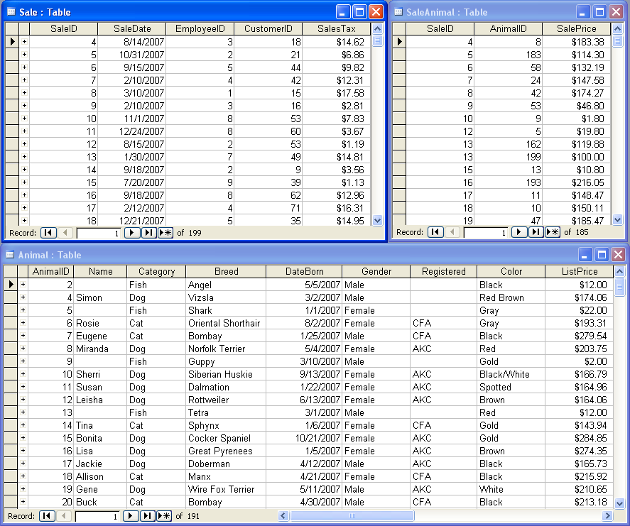
Database Tables (Access)
21
Notes:
21
Database tables in Access. Tables hold data about one business entity. For example, each row in the Animal table holds data about a specific animal.

Slide 22
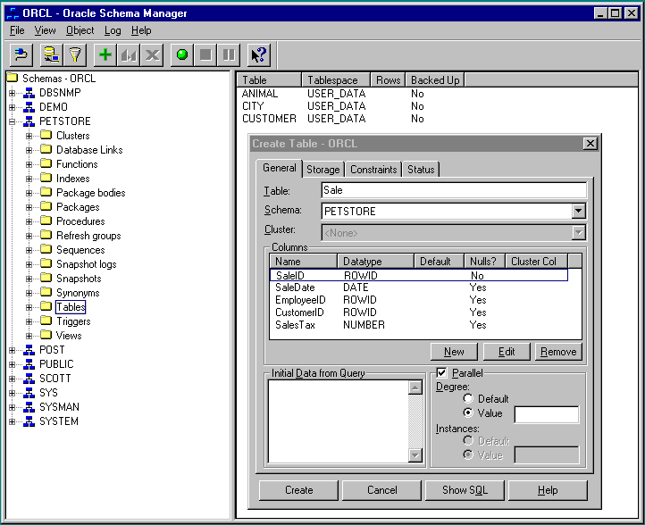
Database Tables (Oracle)
22
Notes:
22

Slide 23
People Who Work with Databases
Database Implementers / Designer /Back End Developer
End Users / Naïve User / Data Entry Operator
Application Programmers / Front End Developer
DBA / System Manager
Notes:
Database Management Systems
23

Slide 24
End Users
Casual users
These are people who use the database occasionally.
Naive users
These are users who constantly querying and updating the database.
Eg. Reservation Clerks of Airline, Railway, Hotel, etc.
Clerks at receiving station of Courier service, Insurance agencies, etc.
Sophisticated Users
People who use for their complex requirements.
Eg. Engineers, Scientists, Business analysts…
Standalone Users
Who maintain database for personal use.
Notes:
Database Management Systems
24

Slide 25
DBA / System Manager
Managing resources
Creation of user accounts
Providing security and User authorization
Managing poor system response time
System Recovery
Tuning the Database
Specifying the database structure
Notes:
Database Management Systems
25

Slide 26


Is a File System a DBMS?
=
Thought Experiment 1:
You and your project partner are editing the same file.
You both save it at the same time.
Whose changes survive?
A) Yours
B) Partner’s
C) Both
D) Neither
E) ???
Thought Experiment 2:
You’re updating a file.
The power goes out.
Which of your changes survive?
Q: How do you write programs over a subsystem when it promises you only “???” ?
A: Very, very carefully!!
A) All
B) None
C) All Since Last Save
D) ???

Slide 27
Current Commercial Outlook
A major part of the software industry:
Oracle, IBM, Microsoft, Sybase
also Informix (now IBM), Teradata
smaller players: java-based dbms, devices, OO, …
Lots of related industries
data warehouse, document management, storage, backup, reporting, business intelligence, app integration, cloud data services
Relational products dominant and evolving
adapting for extensibility (user-defined types), adding native XML support.
Open Source coming on strong
MySQL, PostgreSQL, BerkeleyDB

Slide 28
Examples of Commercial Systems
Vendor | Product
Oracle | Oracle
Microsoft | SQL Server Access
IBM | DB2 Informix
Open source | PostgreSQL
MySQL AB | MySQL
28
Notes:
28
Commercial DBMS vendors. These are the leading DBMS products that you are likely to encounter. Many older systems exist, and dozens of smaller vendors provide complete systems and other tools.

Slide 29
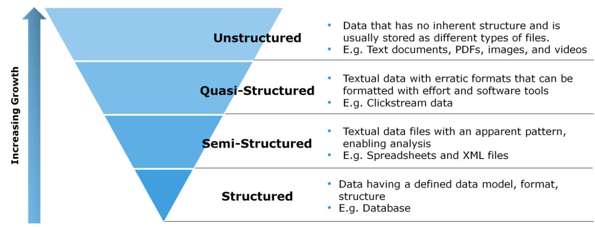

Slide 30
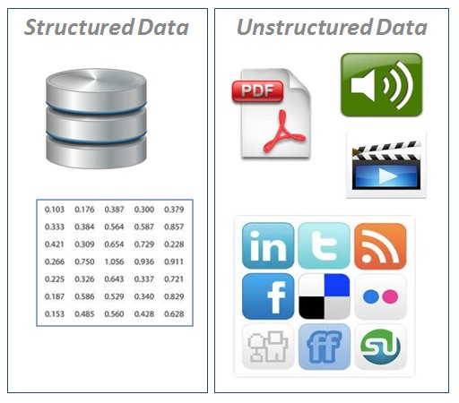

Slide 31
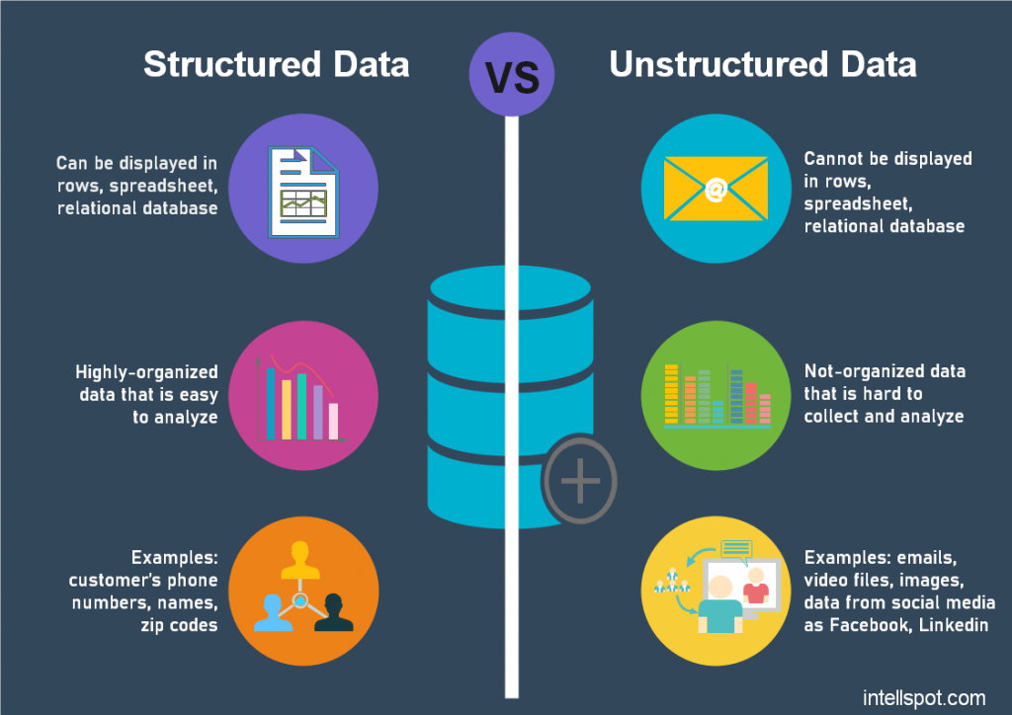

Slide 32
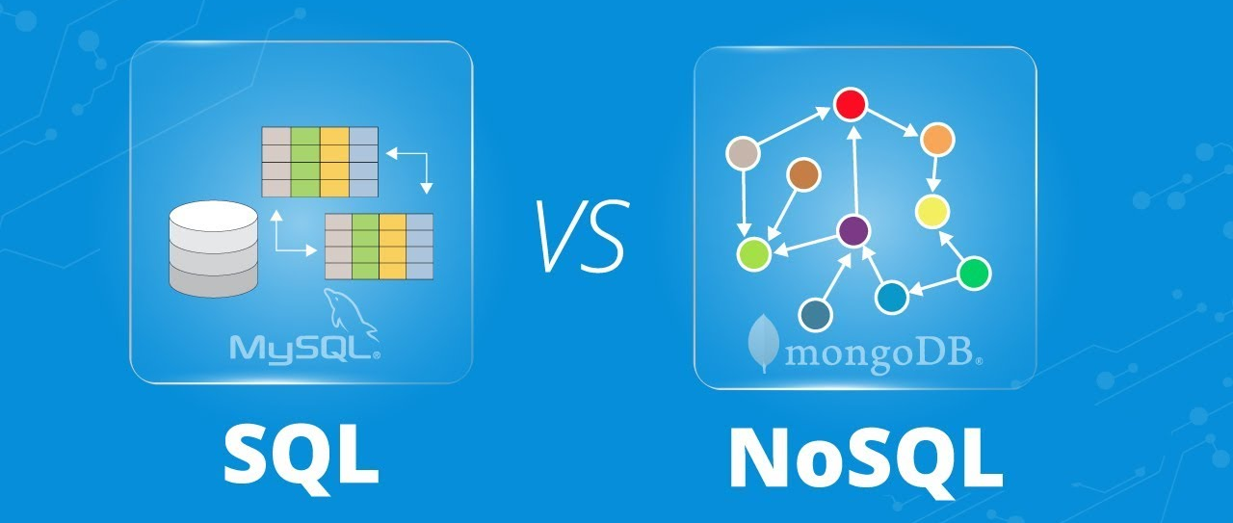

Slide 33
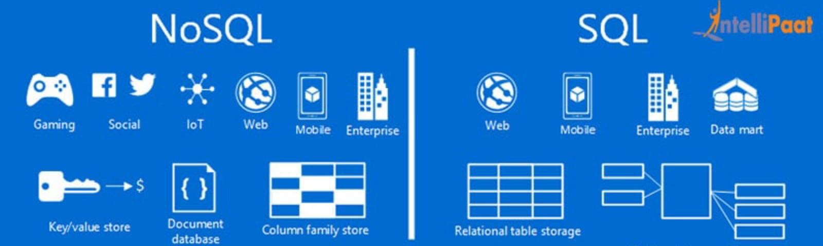

Slide 34
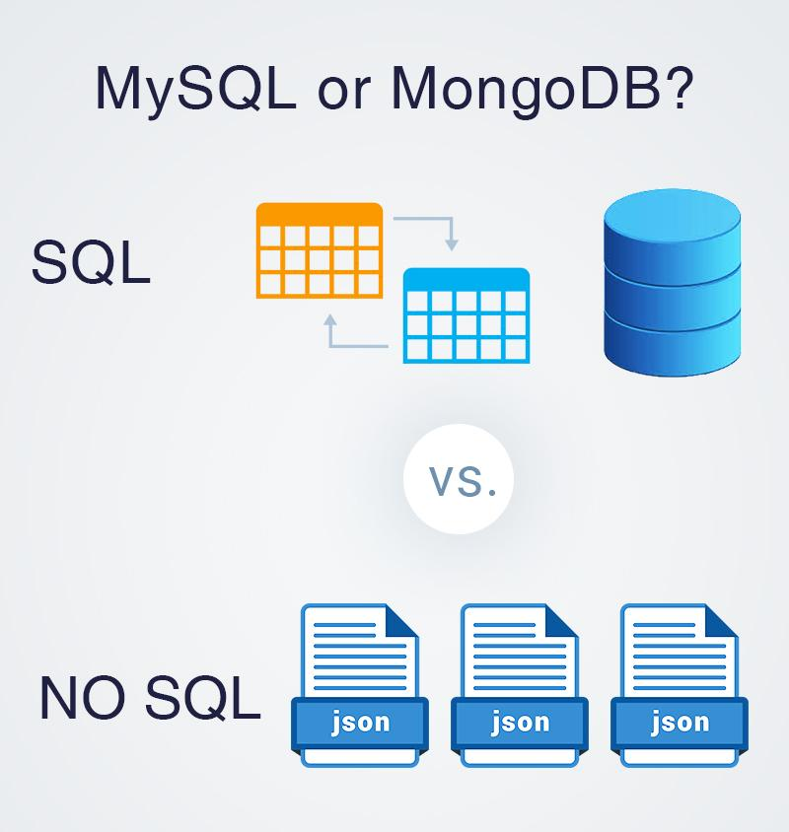

Slide 35
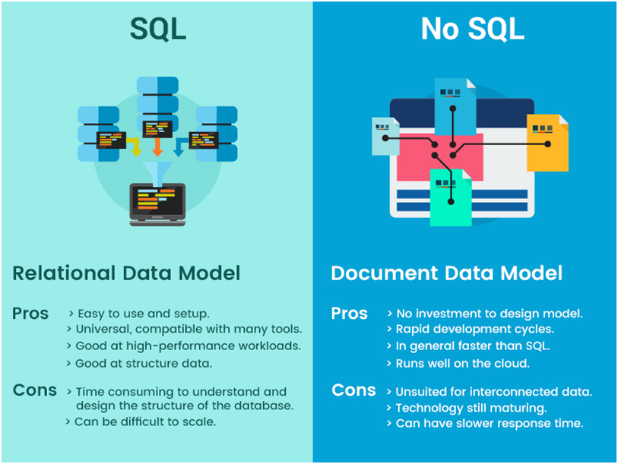

Slide 36
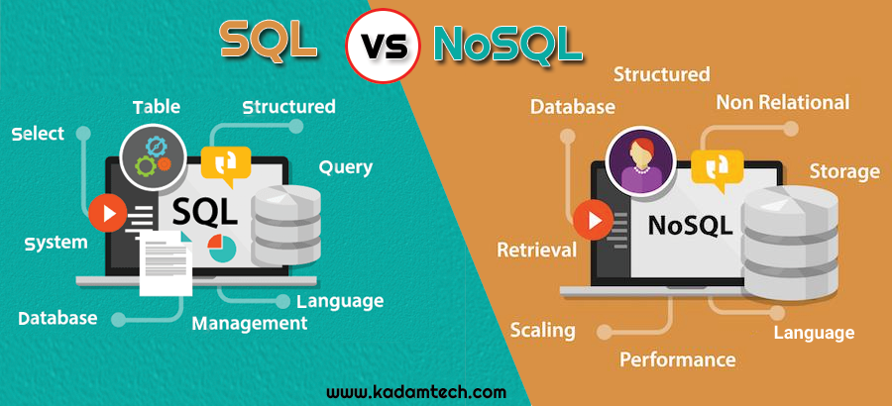

Slide 37
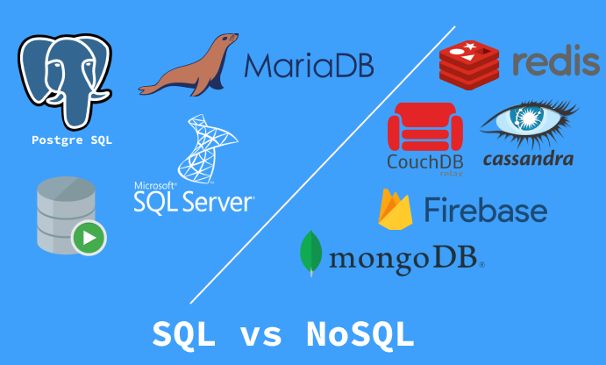

Slide 38
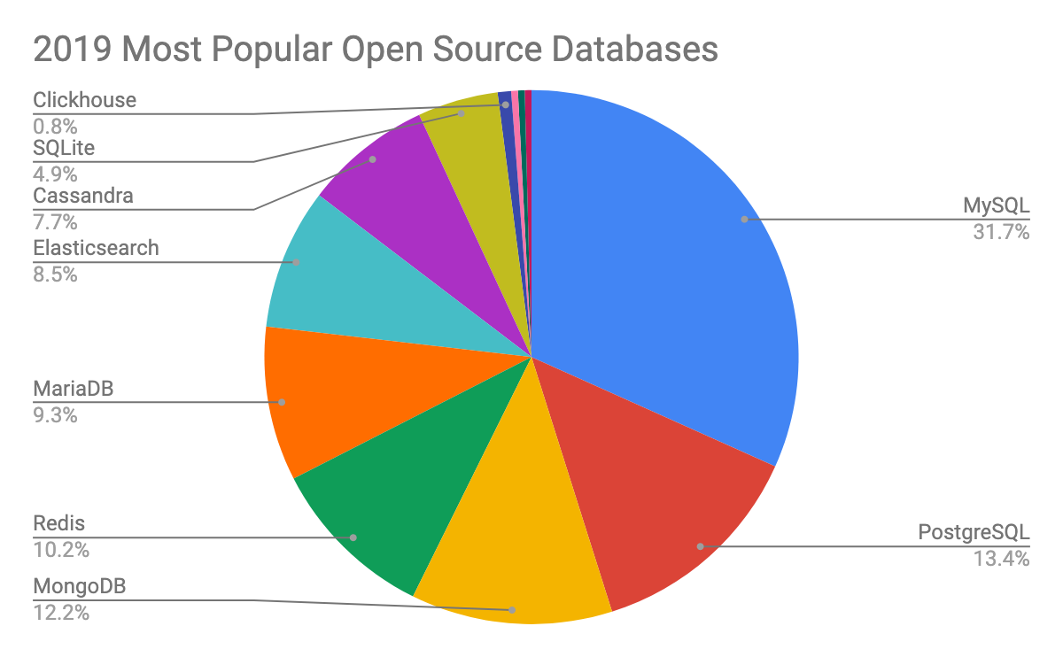
Percona's DBMS Popularity Survey

Slide 39
Database Systems
Types of Database Systems
Number of Users
Single-user
Desktop database
Multiuser
Workgroup database
Enterprise database
Scope
Desktop
Workgroup
Enterprise
Notes:
39

Slide 40
Database Systems
Types of Database Systems
Location
Centralized
Distributed
Use
Transactional (Production)
Decision support
Data warehouse
Notes:
40

Slide 41

Is the WWW a DBMS?
=
Fairly sophisticated search available
crawler indexes pages on the web
Keyword-based search for pages
But, currently
data is mostly unstructured and untyped
search only:
can’t modify the data
can’t get summaries, complex combinations of data
few guarantees provided for freshness of data, consistency across data items, fault tolerance, …
Web sites typically have a DBMS in the background to provide these functions.
The picture is changing
New standards e.g., XML, Semantic Web can help data modeling
Research groups (e.g., at Berkeley) are working on providing some of this functionality across multiple web sites.

Slide 42
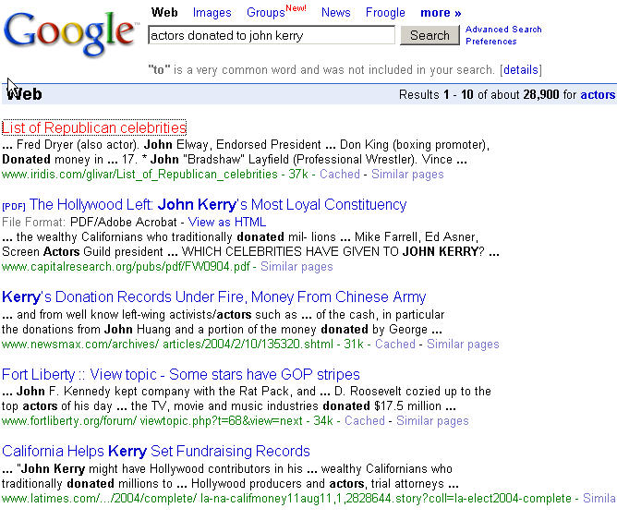
“Search” vs. Query
What if you wanted to find out which actors donated to John Kerry’s presidential campaign?
Try “actors donated to john kerry” in your favorite search engine.

Slide 43
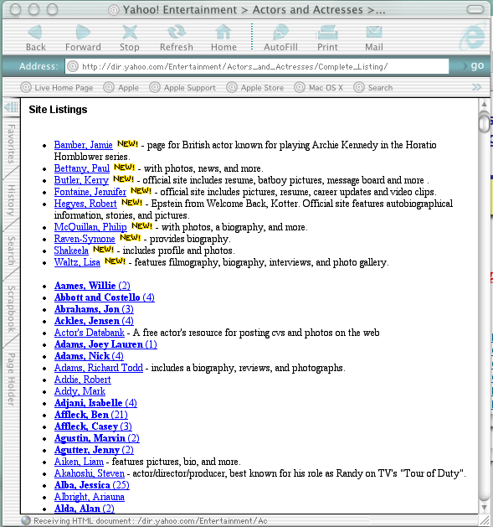
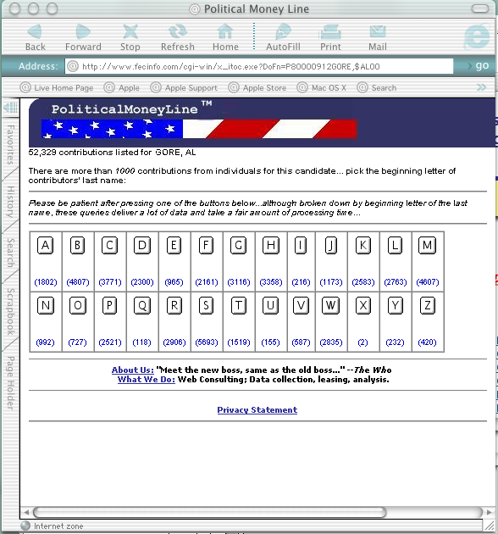

A “Database Query” Approach

Slide 44

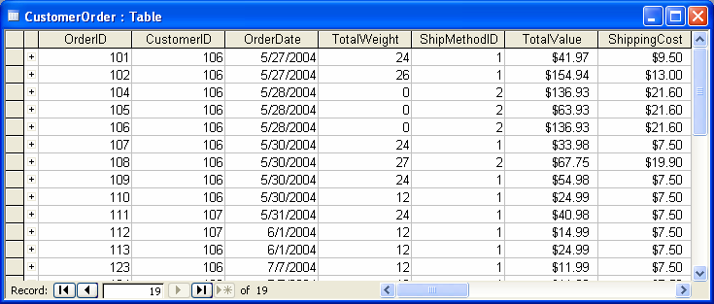


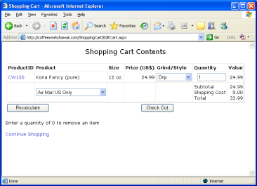
Application Development with a DBMS
SQL Queries
Data
Database Tables
Forms, Reports,
Programs
Database Server
Application Server
Users
Developers and
Administrators
Application Forms
44
Notes:
44
Application development with a DBMS. Developers and administrators define the database in the form of tables. They then create forms and reports on the application server. Users run the application and enter data or make choices.

Slide 45



Web Databases
Database
Developers
Web Server
Users
data
Web forms
and reports
Reports
45
Notes:
45
Web databases. Developers build forms and reports that are stored on a central server. Users access the data and display reports using a standard Web browser.

Slide 46
Goal: Build a Business Application
Tools:
Database Design
SQL (queries)
Programming
Design
Program
SQL
Best:
Spend your time
on design and SQL.
Program
Design
SQL
Worst:
Compensate for poor design
and limited SQL with programming.
46
Notes:
46
Creating business applications. A DBMS can save you hundreds of hours of work in building applications. However, you must design your database correctly and use SQL to do the heavy work.

Slide 47
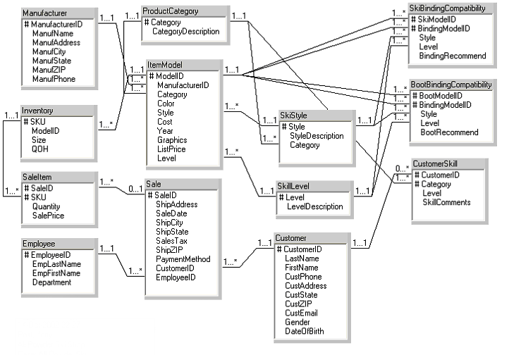
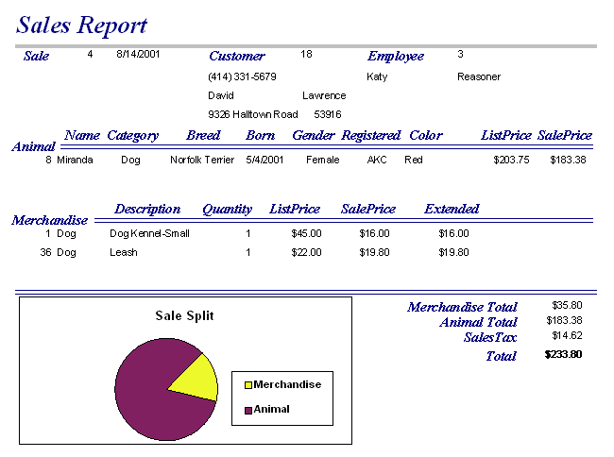
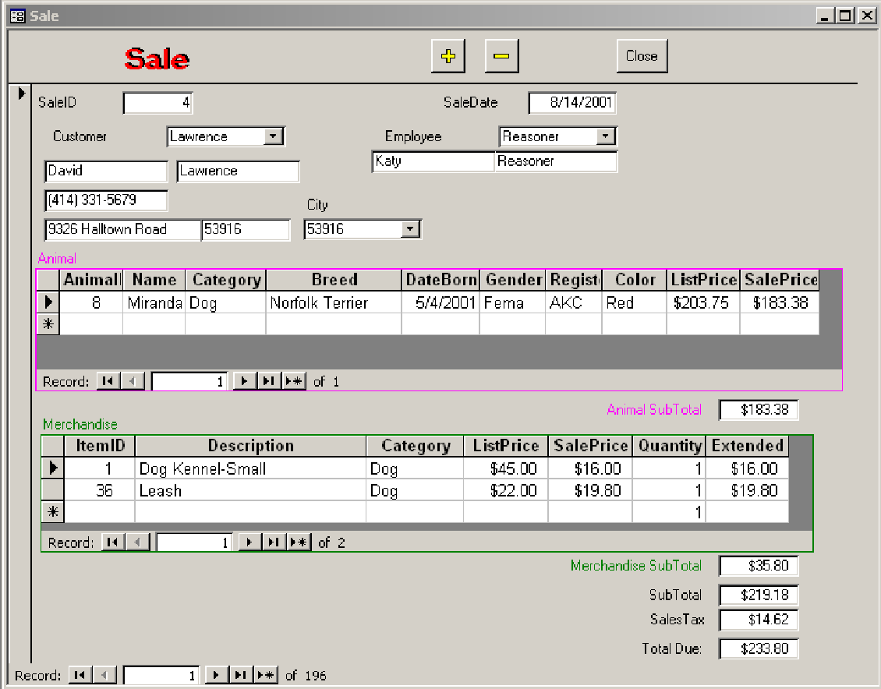

DBMS Application Design
1. Identify business rules.
2. Define tables and relationships.
3. Create input forms and reports.
4. Combine as applications for users.
47
Notes:
47
Steps in database design. The business rules and data are used to define database tables. Forms are used to enter new data. The database system retrieves data to answer queries and produce reports. Users see only the application in terms of forms and reports.

